Slide 1
Introduction to Deep Learning Mechanisms
Week 4
Ph.D. Junetae, Kim
Assistant professor

Slide 2
Introduction to Deep Learning Mechanisms
Start from linear regression
OLS
MSE

Slide 3
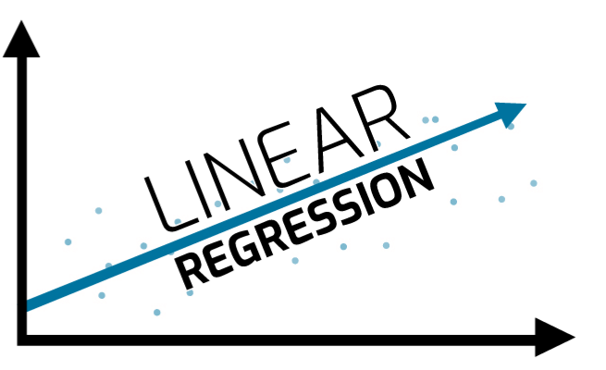
Introduction to Deep Learning Mechanisms
Introduction to linear regression
A linear approach for modelling the relationship between a scalar response and one or more explanatory variables (also known as dependent and independent variables)
The relationships are modeled using linear predictor functions whose unknown model parameters are estimated from the data.

Slide 4
Introduction to Deep Learning Mechanisms
Terminologies
Independent variable:
By the definition of ‘as the value of x changes, the value of y also changes’, the value of x that can change independently
Dependent variable:
Values ​​that change dependently on the independent variable
Linear regression
The process of predicting or explaining changes in the dependent variable y based on the independent variable x

Slide 5
Introduction to Deep Learning Mechanisms
Terminologies
Simple linear regression:
A form in which the value of y is fitted by one independent variable x
Ex) Predicting a test score based on study hours
Multiple linear regression:
A form in which the value of y is fitted by two or more independent variables
Ex) Predicting a test score based on study hours, IQ, and gender

Slide 6
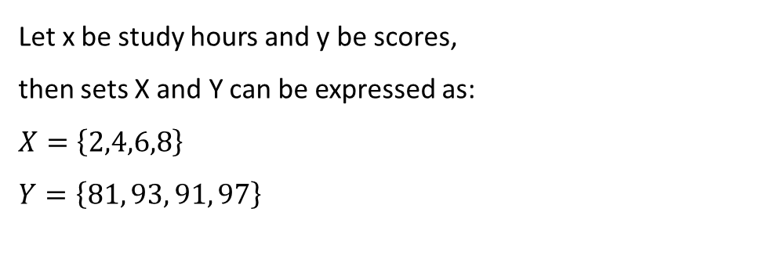
Introduction to Deep Learning Mechanisms
Example of simple linear regression with only one independent variable
Study hours | 2 | 4 | 6 | 8
Scores | 81 | 93 | 91 | 97
Exam scores according to study hours
Let x be study hours and y be scores,
then sets X and Y can be expressed as:
$$X=\left\{2,4,6,8\right\}$$
$$Y=\left\{81, 93, 91, 97\right\}$$

Slide 7
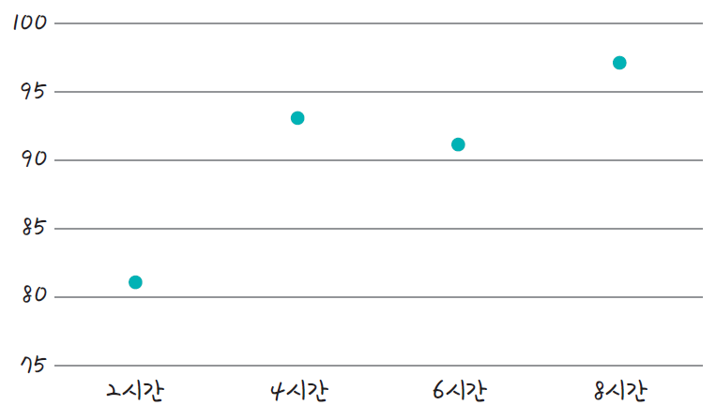
Introduction to Deep Learning Mechanisms
What is an accurate prediction linear line?
Scores
(A)
(B)
(C)
2 hours
4 hours
6 hours
8 hours

Slide 8
Introduction to Deep Learning Mechanisms
What is an accurate prediction linear line?
Scores
(B)
2 hours
4 hours
6 hours
8 hours

Slide 9
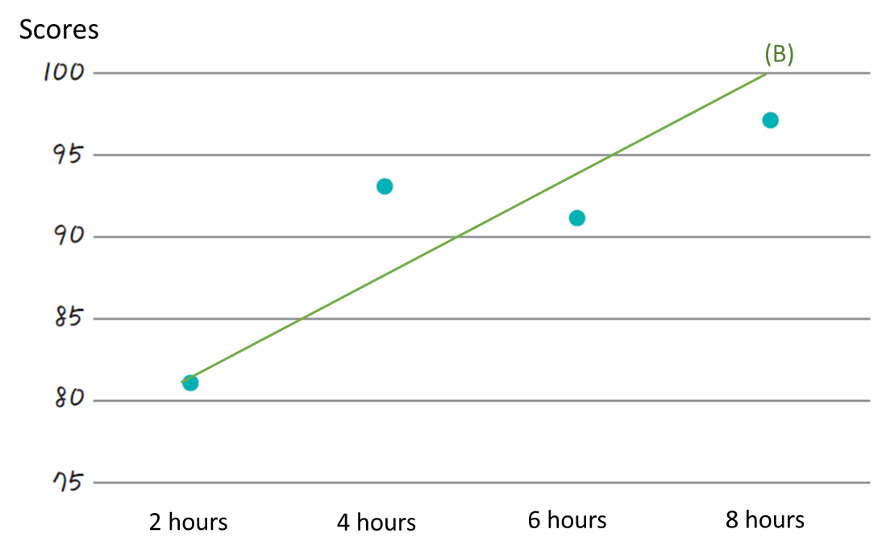
Introduction to Deep Learning Mechanisms
What is an accurate prediction linear line?
Linear regression analysis is the process of finding the line that best represents these points.

Slide 10
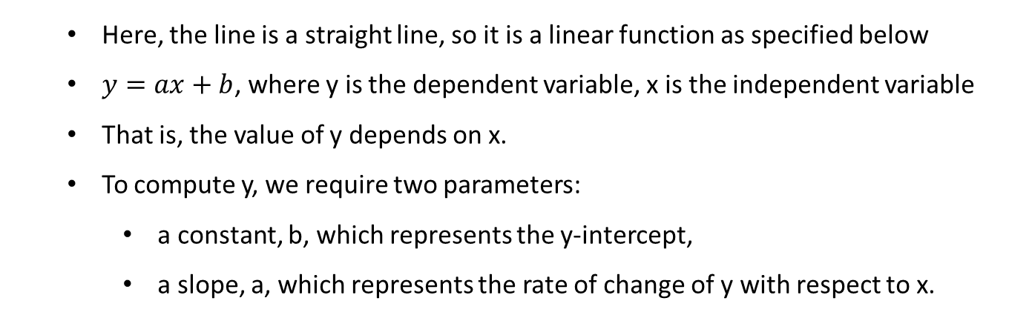
Introduction to Deep Learning Mechanisms
What is an accurate prediction linear line?
Linear regression analysis is the process of finding the line that best represents these points.
Here, the line is a straight line, so it is a linear function as specified below
$y=ax+b$, where y is the dependent variable, x is the independent variable
That is, the value of y depends on x.
To compute y, we require two parameters:
a constant, b, which represents the y-intercept,
a slope, a, which represents the rate of change of y with respect to x.

Slide 11
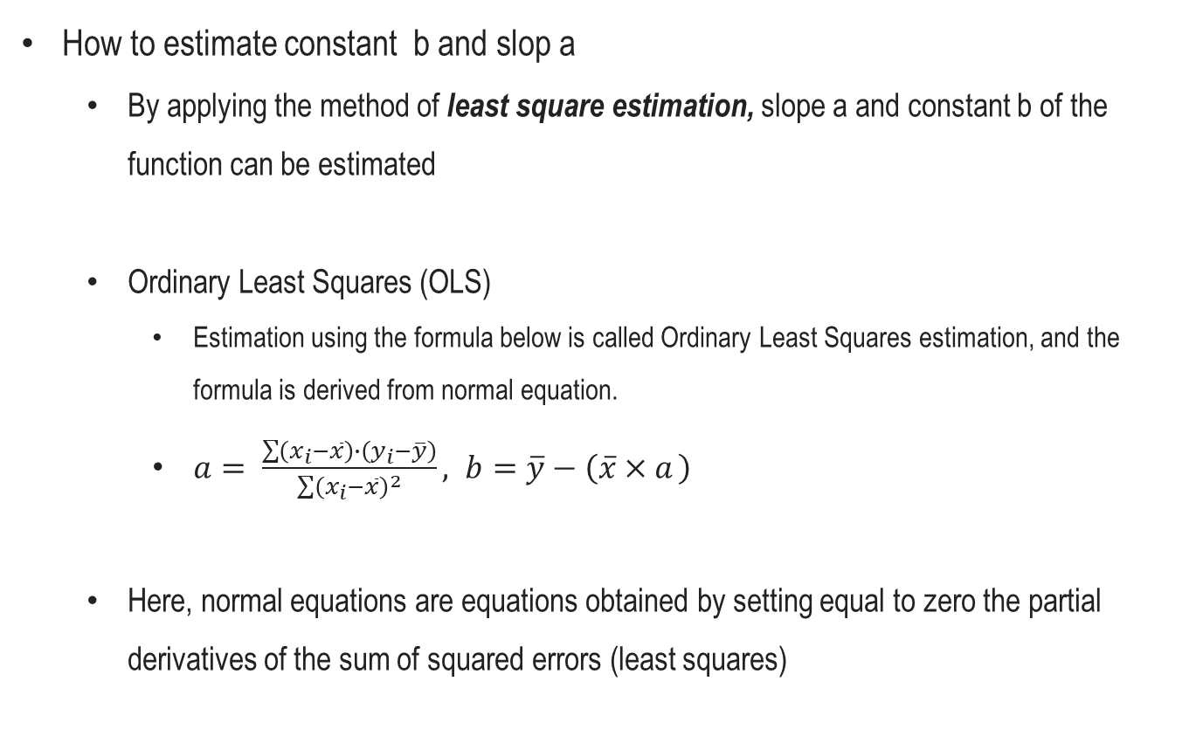
Introduction to Deep Learning Mechanisms
How to estimate constant b and slop a
By applying the method of least square estimation, slope a and constant b of the function can be estimated
Ordinary Least Squares (OLS)
Estimation using the formula below is called Ordinary Least Squares estimation, and the formula is derived from normal equation.
$a= \frac{\sum{\left(x_{i}−\overline{x}\right)∙\left(y_{i}−\overline{y}\right)}}{\sum{{\left(x_{i}−\overline{x}\right)}^{2}}}, b=\overline{y}−\left(\overline{x}×a \right)$
Here, normal equations are equations obtained by setting equal to zero the partial derivatives of the sum of squared errors (least squares)

Slide 12
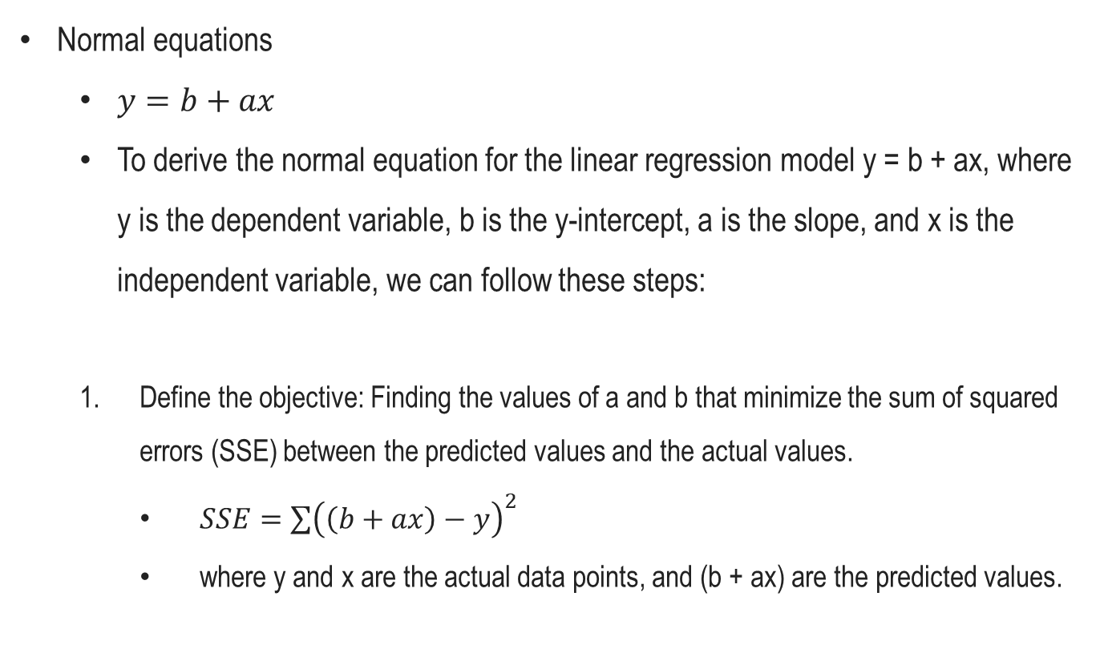
Introduction to Deep Learning Mechanisms
Normal equations
$y=b+ax$
To derive the normal equation for the linear regression model y = b + ax, where y is the dependent variable, b is the y-intercept, a is the slope, and x is the independent variable, we can follow these steps:
Define the objective: Finding the values of a and b that minimize the sum of squared errors (SSE) between the predicted values and the actual values.
$SSE=\sum{{\left(\left(b+ax\right)−y\right)}^{2}}$
where y and x are the actual data points, and (b + ax) are the predicted values.

Slide 13
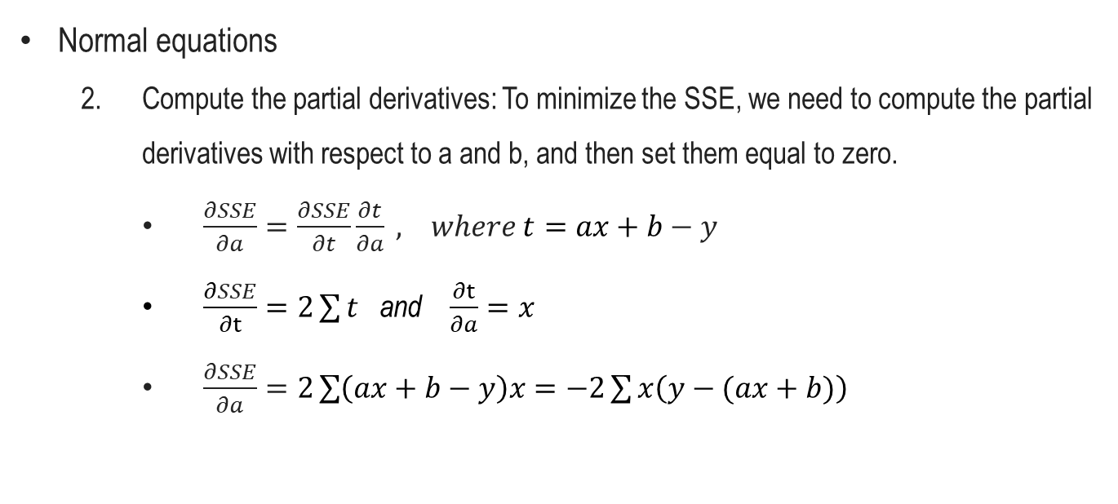
Introduction to Deep Learning Mechanisms
Normal equations
Compute the partial derivatives: To minimize the SSE, we need to compute the partial derivatives with respect to a and b, and then set them equal to zero.
$\frac{∂SSE}{∂a}=\frac{∂SSE}{∂t}\frac{∂t}{∂a} , where t=ax+b−y$
$\frac{∂SSE}{∂t}=2\sum{t}$ and $\frac{∂t}{∂a}=x$
$\frac{∂SSE}{∂a}=2\sum{\left(ax+b−y\right)x}=−2\sum{x\left(y−(ax+b)\right)}$

Slide 14
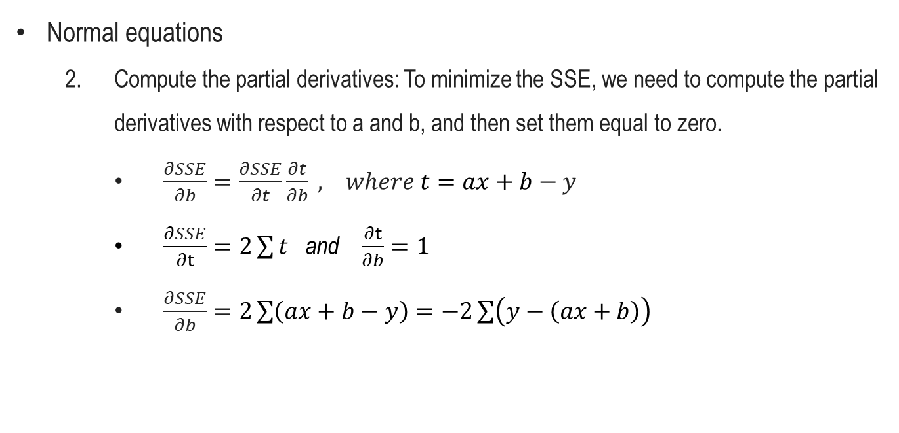
Introduction to Deep Learning Mechanisms
Normal equations
Compute the partial derivatives: To minimize the SSE, we need to compute the partial derivatives with respect to a and b, and then set them equal to zero.
$\frac{∂SSE}{∂b}=\frac{∂SSE}{∂t}\frac{∂t}{∂b} , where t=ax+b−y$
$\frac{∂SSE}{∂t}=2\sum{t}$ and $\frac{∂t}{∂b}=1$
$\frac{∂SSE}{∂b}=2\sum{\left(ax+b−y\right)}=−2\sum{\left(y−\left(ax+b\right)\right)}$

Slide 15

Introduction to Deep Learning Mechanisms
Normal equations
Set the partial derivatives equal to zero:
$\frac{∂SSE}{∂a}=−2\sum{x\left(y−\left(ax+b\right)\right)}=0$
$\frac{∂SSE}{∂b}=−2\sum{\left(y−\left(ax+b\right)\right)}=0$
Simplify the equations:
$\sum{x\left(y−\left(ax+b\right)\right)}=0$
$\sum{\left(y−\left(ax+b\right)\right)}=0$

Slide 16

Introduction to Deep Learning Mechanisms
Normal equations
Expand the equations:
$\sum{\left(yx−ax^{2}−bx\right)}=0$
$\sum{\left(y−ax−b\right)}=0$
Rearrange the equations:
$\sum{yx}−b\sum{x}−a\sum{x^{2}}=0$
$\sum{y}−nb−a\sum{x}=0, where n is the number of data points.$
$b=\frac{a\sum{x}−\sum{y}}{n}$

Slide 17
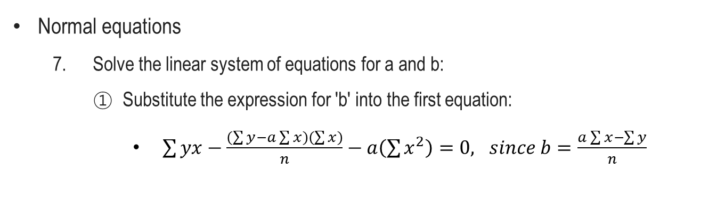
Introduction to Deep Learning Mechanisms
Normal equations
Solve the linear system of equations for a and b:
Substitute the expression for 'b' into the first equation:
$\sum{yx}−\frac{\left(\sum{y}−a\sum{x}\right)\left(\sum{x}\right)}{n}−a\left(\sum{x^{2}}\right)=0, since b=\frac{a\sum{x}−\sum{y}}{n}$

Slide 18
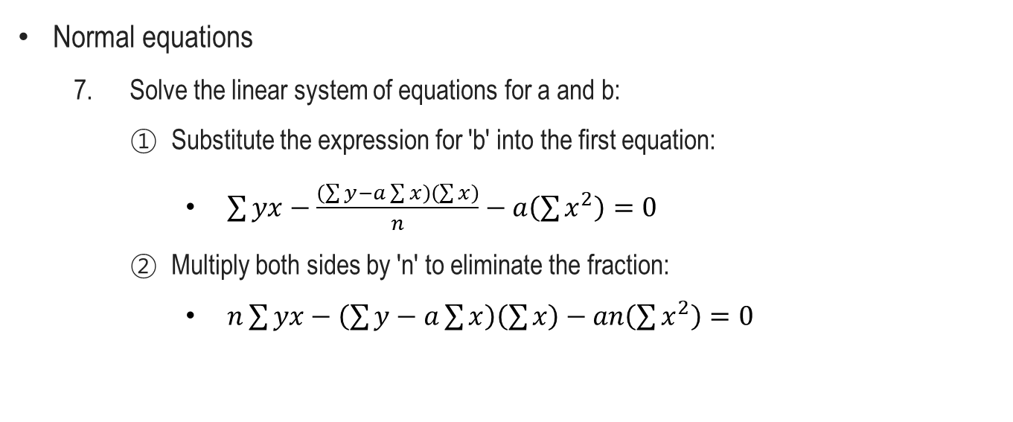
Introduction to Deep Learning Mechanisms
Normal equations
Solve the linear system of equations for a and b:
Substitute the expression for 'b' into the first equation:
$\sum{yx}−\frac{\left(\sum{y}−a\sum{x}\right)\left(\sum{x}\right)}{n}−a\left(\sum{x^{2}}\right)=0$
Multiply both sides by 'n' to eliminate the fraction:
$n\sum{yx}−\left(\sum{y}−a\sum{x}\right)\left(\sum{x}\right)−an\left(\sum{x^{2}}\right)=0$

Slide 19
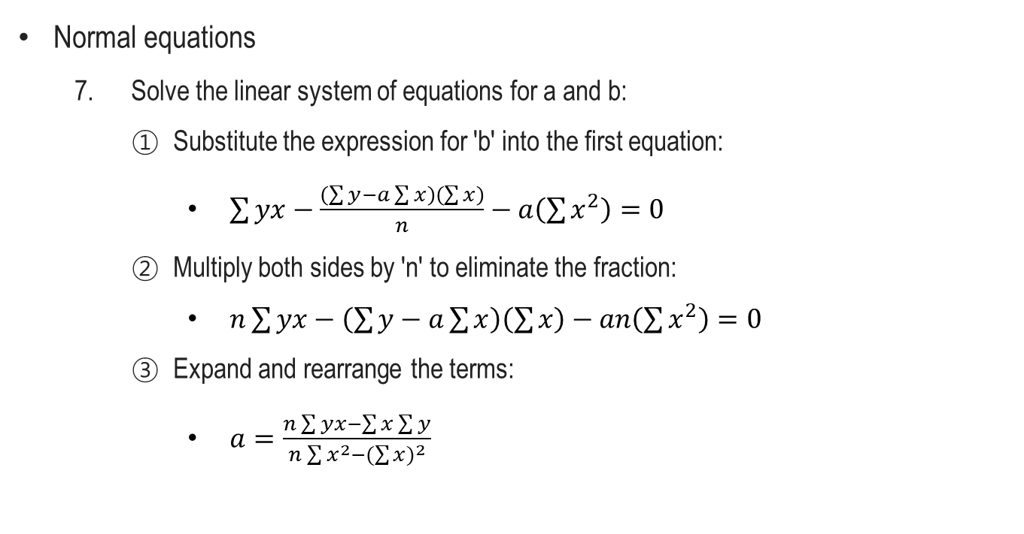
Introduction to Deep Learning Mechanisms
Normal equations
Solve the linear system of equations for a and b:
Substitute the expression for 'b' into the first equation:
$\sum{yx}−\frac{\left(\sum{y}−a\sum{x}\right)\left(\sum{x}\right)}{n}−a\left(\sum{x^{2}}\right)=0$
Multiply both sides by 'n' to eliminate the fraction:
$n\sum{yx}−\left(\sum{y}−a\sum{x}\right)\left(\sum{x}\right)−an\left(\sum{x^{2}}\right)=0$
Expand and rearrange the terms:
$a=\frac{n\sum{yx}−\sum{x}\sum{y}}{n\sum{x^{2}}−{(\sum{x})}^{2}}$

Slide 20

Introduction to Deep Learning Mechanisms
Normal equations
In summary, we can obtain the following normal equations for a and b:
$a=\frac{n\sum{yx}−\sum{y}\sum{x}}{n\sum{(x^{2})}−{(\sum{x})}^{2}}$
$b=\frac{\left(\sum{y}−a\sum{x}\right)}{n}$

Slide 21
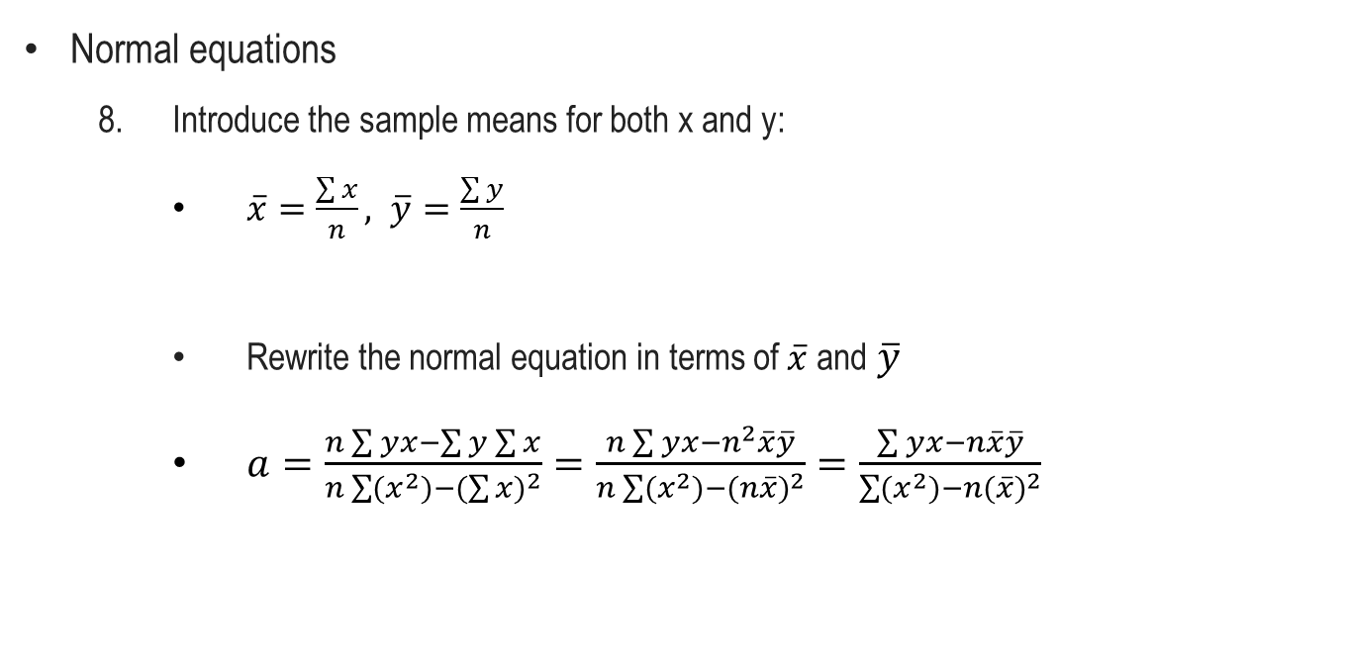
Introduction to Deep Learning Mechanisms
Normal equations
Introduce the sample means for both x and y:
$\overline{x}=\frac{\sum{x}}{n}, \overline{y}=\frac{\sum{y}}{n}$
Rewrite the normal equation in terms of $\overline{x}$and $\overline{y}$
$a=\frac{n\sum{yx}−\sum{y}\sum{x}}{n\sum{(x^{2})}−{(\sum{x})}^{2}}=\frac{n\sum{yx}−n^{2}\overline{x}\overline{y}}{n\sum{(x^{2})}−{(n\overline{x})}^{2}}=\frac{\sum{yx}−n\overline{x}\overline{y}}{\sum{(x^{2})}−{n(\overline{x})}^{2}}$

Slide 22

Introduction to Deep Learning Mechanisms
Normal equations
Rewrite the numerator to be in the form of sums involving $(x−\overline{x})$and $(y−\overline{y})$:
$a=\frac{\sum{yx}−n\overline{x}\overline{y}}{\sum{(x^{2})}−{n(\overline{x})}^{2}}=\frac{\sum{(yx−\overline{x}\overline{y}})}{\sum{(x^{2})}−{n(\overline{x})}^{2}}$
$yx−\overline{x}\overline{y}=\left(x−\overline{x}\right)\left(y−\overline{y}\right)+\overline{x}\left(y−\overline{y}\right)+\overline{y}\left(x−\overline{x}\right)$
Numerator $=\sum{(\left(x−\overline{x}\right)\left(y−\overline{y}\right)+\overline{x}\left(y−\overline{y}\right)+\overline{y}\left(x−\overline{x}\right)})$

Slide 23

Introduction to Deep Learning Mechanisms
Normal equations
Rewrite the numerator to be in the form of sums involving $(x−\overline{x})$and $(y−\overline{y})$:
Numerator $=\sum{(\left(x−\overline{x}\right)\left(y−\overline{y}\right)+\overline{x}\left(y−\overline{y}\right)+\overline{y}\left(x−\overline{x}\right)})$
$\overline{x}\sum{\left(y−\overline{y}\right)}=0,$
$since \overline{x}\sum{\left(y−\overline{y}\right)}=\overline{x}\left(\sum{y}−\sum{\overline{y}}\right)$
$\overline{x}\left(\sum{y}−\sum{\overline{y}}\right)=\overline{x}\left(n\overline{y}−n\overline{y}\right), since \overline{y}=\frac{\sum{y}}{n}$
Likewise,
$\overline{y}\sum{\left(x−\overline{x}\right)}=0$

Slide 24

Introduction to Deep Learning Mechanisms
Normal equations
Rewrite the numerator to be in the form of sums involving $(x−\overline{x})$and $(y−\overline{y})$:
$a=\frac{\sum{(\left(x−\overline{x}\right)\left(y−\overline{y}\right)+\overline{x}\left(y−\overline{y}\right)+\overline{y}\left(x−\overline{x}\right)}))}{\sum{(x^{2})}−{n(\overline{x})}^{2}}$
The equation simplifies to:
$a=\frac{\sum{(x−\overline{x})(y−\overline{y})}}{\sum{(x^{2})}−{n(\overline{x})}^{2}}$

Slide 25

Introduction to Deep Learning Mechanisms
Normal equations
Recall 'b'
$b=\frac{\left(\sum{y}−a\sum{x}\right)}{n}$
$b=\frac{1}{n}\sum{y}−\frac{a}{n}\sum{x}$
Simplify the equation by canceling out the 'n' terms:
$b=\overline{y}−a\overline{x}$

Slide 26
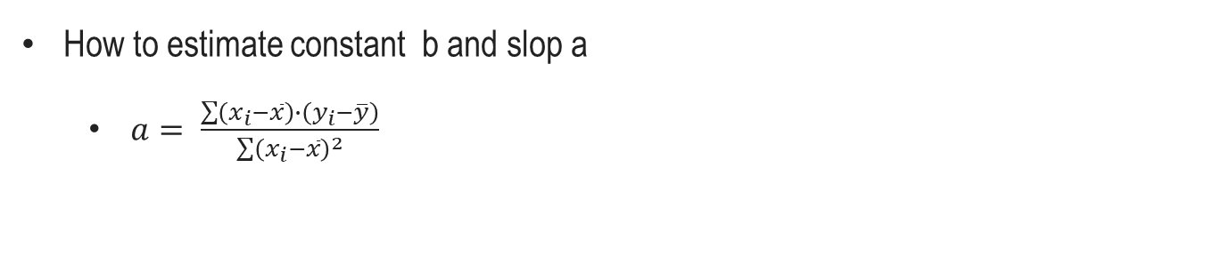


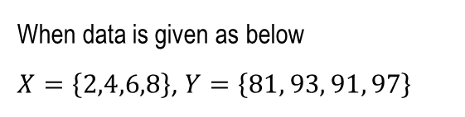
Introduction to Deep Learning Mechanisms
How to estimate constant b and slop a
$a= \frac{\sum{\left(x_{i}−\overline{x}\right)∙\left(y_{i}−\overline{y}\right)}}{\sum{{\left(x_{i}−\overline{x}\right)}^{2}}}$
When data is given as below
$X=\left\{2,4,6,8\right\}$, $Y=\left\{81, 93, 91, 97\right\}$
$\overline{x}=\frac{(2+4+6+8)}{4}=5$ , $\overline{y}=\frac{(81+93+91+97)}{4}=90.5$
$$a=\frac{\left(2−5\right)\left(91−90.5\right)+\left(4−5\right)\left(93−90.5\right)+\left(6−5\right)\left(91−90.5\right)+\left(8−5\right)\left(97−90.5\right)}{{\left(2−5\right)}^{2}+{\left(4−5\right)}^{2}+{\left(6−5\right)}^{2}+{\left(8−5\right)}^{2}}$$
$$a=\frac{46}{20}=2.3$$

Slide 27
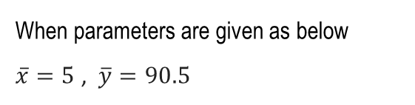


Introduction to Deep Learning Mechanisms
How to estimate constant b and slop a
$b=\overline{y}−\left(\overline{x}×a \right)$
When parameters are given as below
$\overline{x}=5$ , $\overline{y}=90.5$
$$b=90.5−\left(2.3×5 \right)=79$$

Slide 28

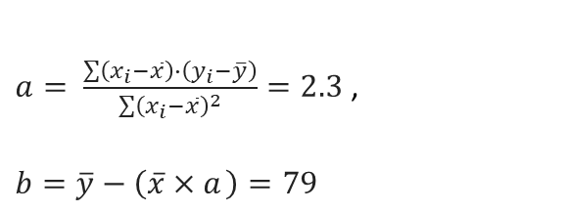
Introduction to Deep Learning Mechanisms
Estimated linear function
$y=2.3x+79$
$a= \frac{\sum{\left(x_{i}−\overline{x}\right)∙\left(y_{i}−\overline{y}\right)}}{\sum{{\left(x_{i}−\overline{x}\right)}^{2}}}=2.3$ ,
$b=\overline{y}−\left(\overline{x}×a \right)$ $=79$

Slide 29
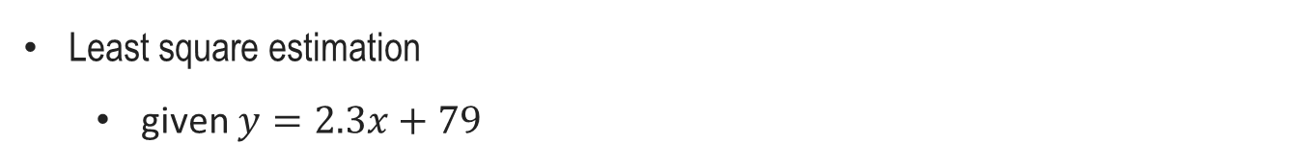
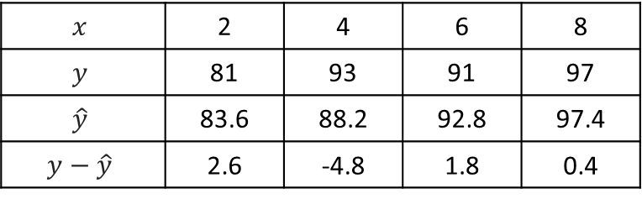
Introduction to Deep Learning Mechanisms
Least square estimation
given $y=2.3x+79$
$$x$$ | 2 | 4 | 6 | 8
$$y$$ | 81 | 93 | 91 | 97
$$\hat{y}$$ | 83.6 | 88.2 | 92.8 | 97.4
$$y−\hat{y}$$ | 2.6 | -4.8 | 1.8 | 0.4

Slide 30
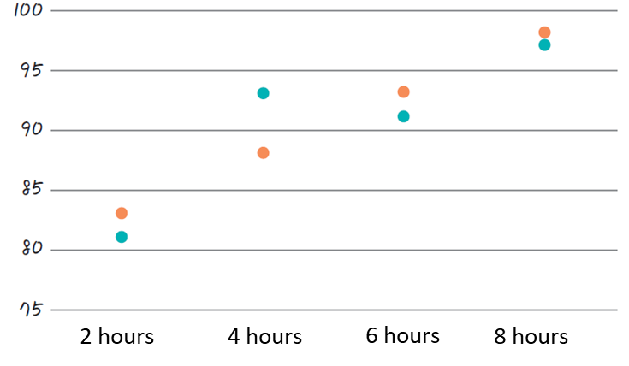

Introduction to Deep Learning Mechanisms
Least square estimation
given $y=2.3x+79$
$$x$$ | 2 | 4 | 6 | 8
$$y$$ | 81 | 93 | 91 | 97
$$\hat{y}$$ | 83.6 | 88.2 | 92.8 | 97.4
$$y−\hat{y}$$ | 2.6 | -4.8 | 1.8 | 0.4

Slide 31
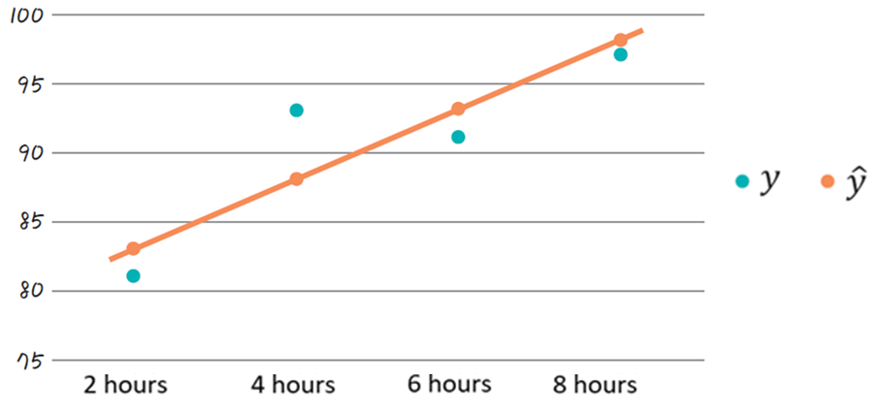
Introduction to Deep Learning Mechanisms
Least square estimation
given $y=2.3x+79$
$$x$$ | 2 | 4 | 6 | 8
$$y$$ | 81 | 93 | 91 | 97
$$\hat{y}$$ | 83.6 | 88.2 | 92.8 | 97.4
$$y−\hat{y}$$ | 2.6 | -4.8 | 1.8 | 0.4
The linear line with the lowest error

Slide 32


Introduction to Deep Learning Mechanisms
Coding exercise for least square estimation
(1) Assigning values into vectors x and y, using numpy
(2) Calculating mean of x and y

Slide 33
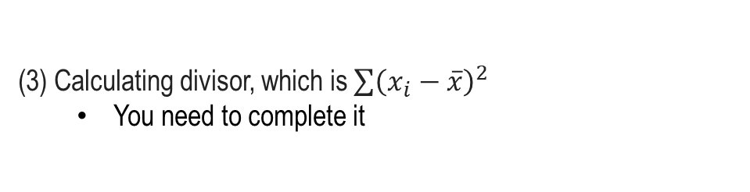
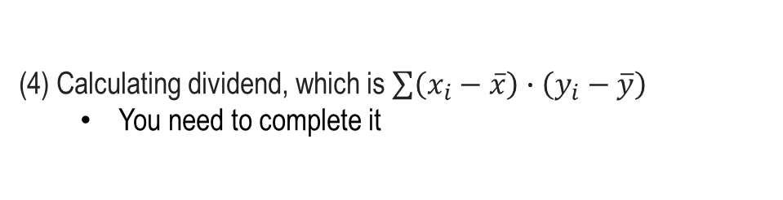
Introduction to Deep Learning Mechanisms
Coding exercise for least square estimation
(3) Calculating divisor, which is $\sum{{\left(x_{i}−\overline{x}\right)}^{2}}$
You need to complete it
(4) Calculating dividend, which is $\sum{\left(x_{i}−\overline{x}\right)∙\left(y_{i}−\overline{y}\right)}$
You need to complete it

Slide 34
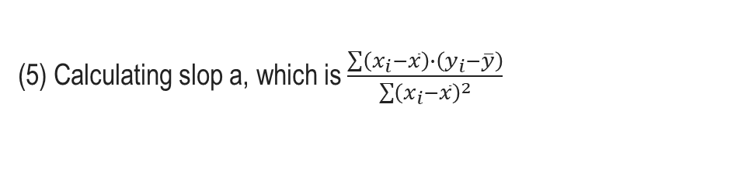
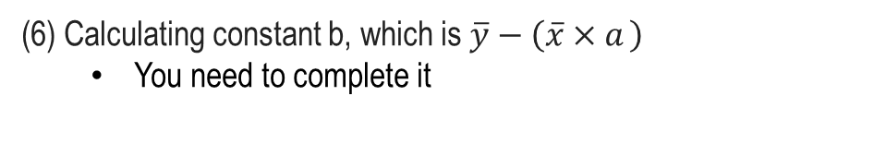
Introduction to Deep Learning Mechanisms
Coding exercise for least square estimation
(5) Calculating slop a, which is $\frac{\sum{\left(x_{i}−\overline{x}\right)∙\left(y_{i}−\overline{y}\right)}}{\sum{{\left(x_{i}−\overline{x}\right)}^{2}}}$
(6) Calculating constant b, which is $\overline{y}−\left(\overline{x}×a \right)$
You need to complete it

Slide 35
Introduction to Deep Learning Mechanisms
Coding exercise for least square estimation
https://colab.research.google.com/github/JunetaeKim/DeepLearningClass/blob/main/Week4/W4_OLS.ipynb

Slide 36
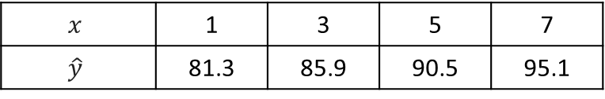
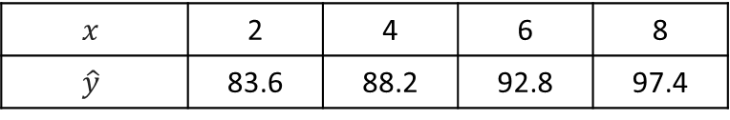
Introduction to Deep Learning Mechanisms
Least square estimation
given $y=2.3x+79$
$$x$$ | 2 | 4 | 6 | 8
$$\hat{y}$$ | 83.6 | 88.2 | 92.8 | 97.4
Generalization
$$x$$ | 1 | 3 | 5 | 7
$$\hat{y}$$ | 81.3 | 85.9 | 90.5 | 95.1

Slide 37
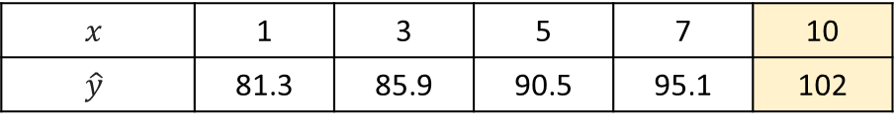
Introduction to Deep Learning Mechanisms
Least square estimation
given $y=2.3x+79$
$$x$$ | 2 | 4 | 6 | 8
$$\hat{y}$$ | 83.6 | 88.2 | 92.8 | 97.4
Generalization
$$x$$ | 1 | 3 | 5 | 7 | 10
$$\hat{y}$$ | 81.3 | 85.9 | 90.5 | 95.1 | 102
Limitation of linear regression

Slide 38
Introduction to Deep Learning Mechanisms
Limitation of OLS
OLS only works in solving the problem of the linear functional relationship
→ Recent machine learning and deep learning algorithms solve nonlinear problems

Slide 39
Introduction to Deep Learning Mechanisms
Limitation of OLS
OLS works when the data is relatively small.
All matrices with data must be loaded into RAM memory to do OLS
→ Since the size of data used in recent machine learning and deep learning is large, the parameters (a, b) are iteratively estimated after partitioning the data.
Score | IQ | Study hours
Iteration #1
Iteration #2

Slide 40
Introduction to Deep Learning Mechanisms
Introduction to gradient descent algorithm
A first-order iterative optimization algorithm for finding a local minimum of a differentiable function.

Slide 41
Introduction to Deep Learning Mechanisms
Introduction to gradient descent algorithm
A first-order iterative optimization algorithm for finding a local minimum of a differentiable function.
Details to be learned later

Slide 42
Introduction to Deep Learning Mechanisms
Errors(Losses) required for applying gradient descent algorithm
When the error of each linear line can be calculated, the parameter set (a, b) can be updated so that the error becomes smaller.

Slide 43
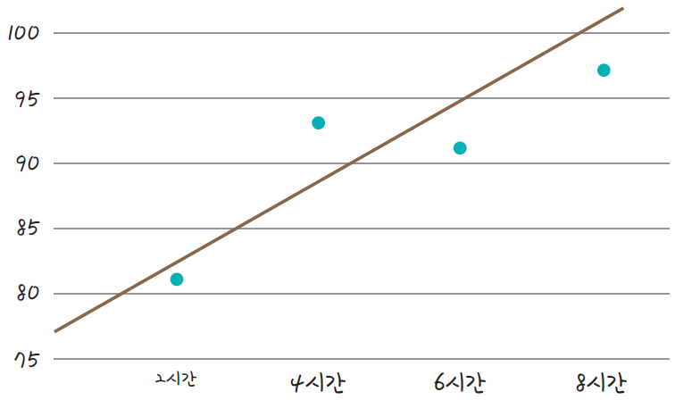
Introduction to Deep Learning Mechanisms
How to calculate error
Let's estimate the values ​​of a and b by minimizing the error when given an arbitrary value.
Assuming that the slope a and the intercept y are arbitrary numbers 3 and 76, the following line is plotted
2 Hours
4 Hours
6 Hours
8 Hours

Slide 44
Introduction to Deep Learning Mechanisms
How to calculate error
The distance between each point and the graph is the error
The smaller the sum of these vertical lines, the more accurate the linear line..
2 Hours
4 Hours
6 Hours
8 Hours

Slide 45
Introduction to Deep Learning Mechanisms
How to calculate error
If the slope is too large, the two high score may be underpredicted, as shown in the figure below.

Slide 46
Introduction to Deep Learning Mechanisms
How to calculate error
If the slope is too small, the three high score may be overpredicted, as shown in the figure below.

Slide 47
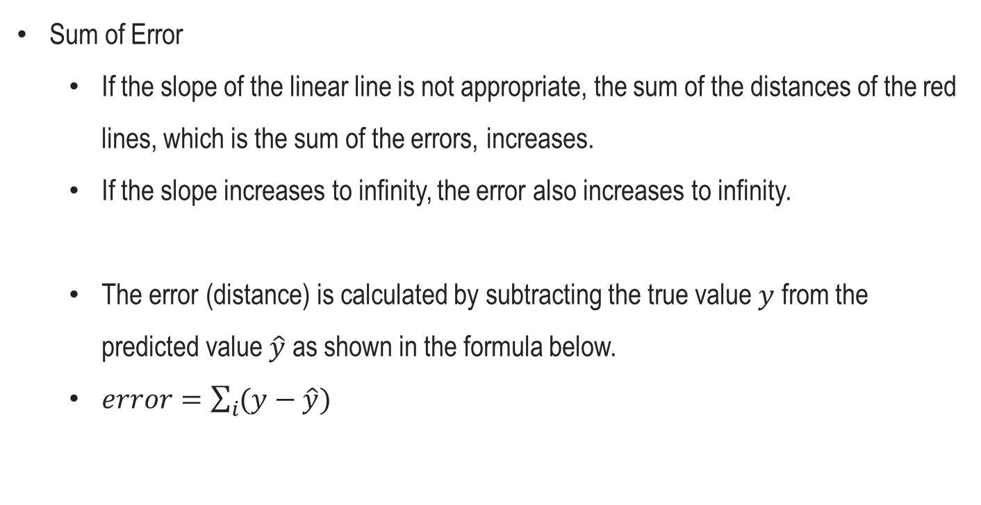
Introduction to Deep Learning Mechanisms
Sum of Error
If the slope of the linear line is not appropriate, the sum of the distances of the red lines, which is the sum of the errors, increases.
If the slope increases to infinity, the error also increases to infinity.
The error (distance) is calculated by subtracting the true value $y$ from the predicted value $\hat{y}$ as shown in the formula below.
$error=\sum_{i}{(y−\hat{y})}$

Slide 48

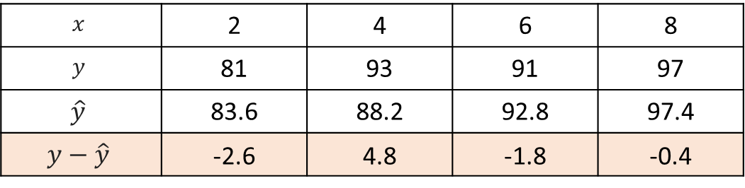
Introduction to Deep Learning Mechanisms
Limitation of sum of errors
given $y=2.3x+79$
$$x$$ | 2 | 4 | 6 | 8
$$y$$ | 81 | 93 | 91 | 97
$$\hat{y}$$ | 83.6 | 88.2 | 92.8 | 97.4
$$y−\hat{y}$$ | -2.6 | 4.8 | -1.8 | -0.4
If we add up all the errors obtained,
we get = 0 since -2.6 + 4.8 -1.8 – 0.4 = 0
Since positive and negative numbers are together, simply adding the error may result in zero.
Therefore, the simple sum is not appropriate.

Slide 49
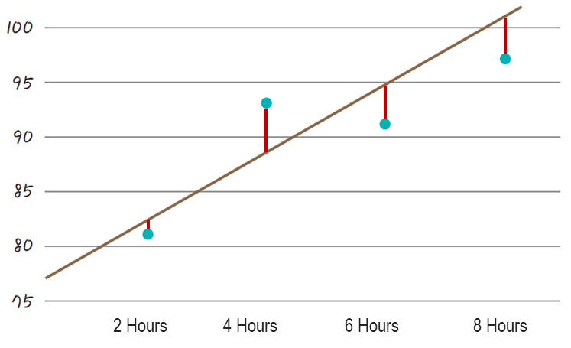
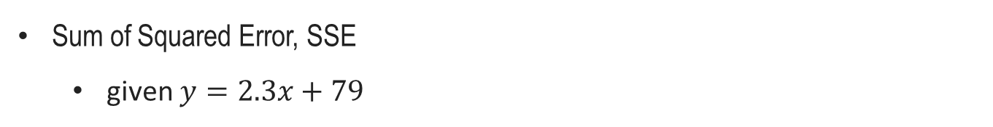
Introduction to Deep Learning Mechanisms
Sum of Squared Error, SSE
given $y=2.3x+79$
$$x$$ | 2 | 4 | 6 | 8
$$y$$ | 81 | 93 | 91 | 97
$$\hat{y}$$ | 83.6 | 88.2 | 92.8 | 97.4
$$y−\hat{y}$$ | -2.6 | 4.8 | -1.8 | -0.4
The errors must belong to the set of positive real numbers that are at least zero.

Slide 50
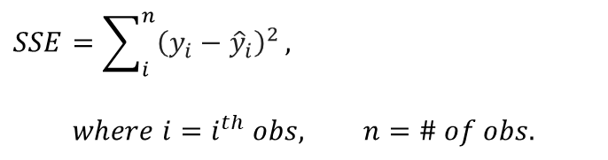
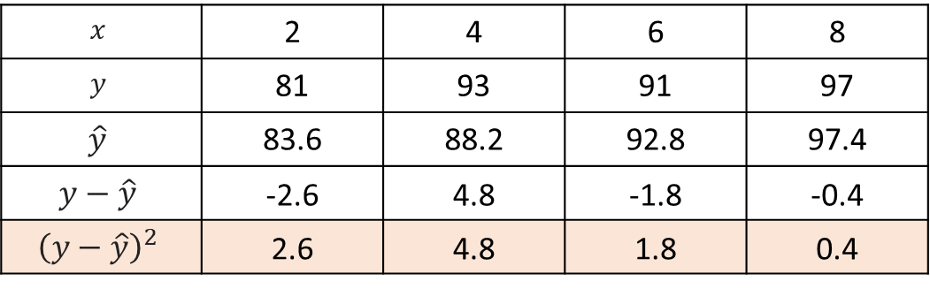
Introduction to Deep Learning Mechanisms
Sum of Squared Error, SSE
given $y=2.3x+79$
$$x$$ | 2 | 4 | 6 | 8
$$y$$ | 81 | 93 | 91 | 97
$$\hat{y}$$ | 83.6 | 88.2 | 92.8 | 97.4
$$y−\hat{y}$$ | -2.6 | 4.8 | -1.8 | -0.4
$${\left(y−\hat{y}\right)}^{2}$$ | 2.6 | 4.8 | 1.8 | 0.4
value to the power of 2
$$SSE=\sum_{i}^{n}{{\left(y_{i}−{\hat{y}}_{i}\right)}^{2}},$$
$$where i=i^{th} obs, n=\# of obs.$$

Slide 51
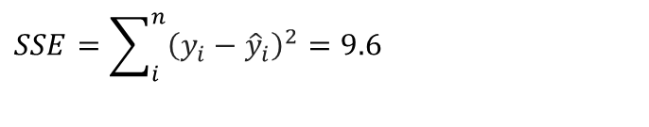
Introduction to Deep Learning Mechanisms
Sum of Squared Error, SSE
given $y=2.3x+79$
$$x$$ | 2 | 4 | 6 | 8
$$y$$ | 81 | 93 | 91 | 97
$$\hat{y}$$ | 83.6 | 88.2 | 92.8 | 97.4
$$y−\hat{y}$$ | -2.6 | 4.8 | -1.8 | -0.4
$${\left(y−\hat{y}\right)}^{2}$$ | 2.6 | 4.8 | 1.8 | 0.4
value to the power of 2
$$SSE=\sum_{i}^{n}{{\left(y_{i}−{\hat{y}}_{i}\right)}^{2}}=9.6$$
If we add up all the squared errors, we get 9.6

Slide 52
Introduction to Deep Learning Mechanisms
Weakness of SSE
Since it adds up all squared errors,
it is susceptible to outlier effects.
vs

Slide 53
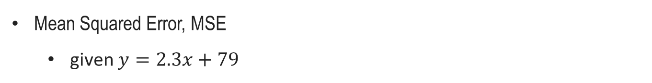
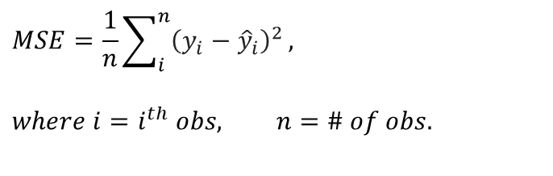
Introduction to Deep Learning Mechanisms
Mean Squared Error, MSE
given $y=2.3x+79$
$$x$$ | 2 | 4 | 6 | 8
$$y$$ | 81 | 93 | 91 | 97
$$\hat{y}$$ | 83.6 | 88.2 | 92.8 | 97.4
$$y−\hat{y}$$ | -2.6 | 4.8 | -1.8 | -0.4
$${\left(y−\hat{y}\right)}^{2}$$ | 2.6 | 4.8 | 1.8 | 0.4
value to the power of 2
$$MSE=\frac{1}{n}\sum_{i}^{n}{{\left(y_{i}−{\hat{y}}_{i}\right)}^{2}},$$
$$where i=i^{th} obs, n=\# of obs.$$

Slide 54
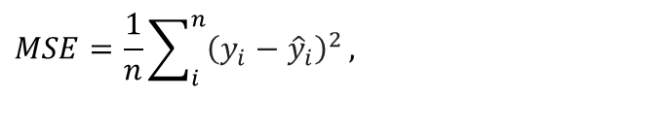
Introduction to Deep Learning Mechanisms
Mean Squared Error, MSE
given $y=2.3x+79$
$$x$$ | 2 | 4 | 6 | 8
$$y$$ | 81 | 93 | 91 | 97
$$\hat{y}$$ | 83.6 | 88.2 | 92.8 | 97.4
$$y−\hat{y}$$ | -2.6 | 4.8 | -1.8 | -0.4
$${\left(y−\hat{y}\right)}^{2}$$ | 2.6 | 4.8 | 1.8 | 0.4
value to the power of 2
$$MSE=\frac{1}{n}\sum_{i}^{n}{{\left(y_{i}−{\hat{y}}_{i}\right)}^{2}},$$
If we take the mean of SE, we get 2.4

Slide 55

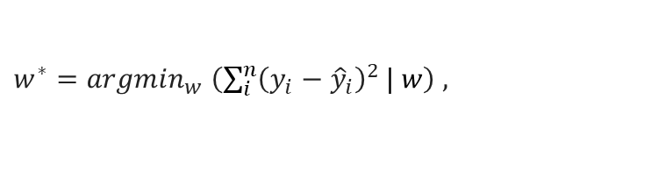
Introduction to Deep Learning Mechanisms
Mean Squared Error, MSE
given $y=2.3x+79$
$$x$$ | 2 | 4 | 6 | 8
$$y$$ | 81 | 93 | 91 | 97
$$\hat{y}$$ | 83.6 | 88.2 | 92.8 | 97.4
$$y−\hat{y}$$ | -2.6 | 4.8 | -1.8 | -0.4
$${\left(y−\hat{y}\right)}^{2}$$ | 2.6 | 4.8 | 1.8 | 0.4
value to the power of 2
Finally, the objective function for minimizing MSE can be expressed as:
$w^{∗}={argmin}_{w} \left(\sum_{i}^{n}{{\left(y_{i}−{\hat{y}}_{i}\right)}^{2}}| w\right) ,$
$$where w=\left\{a,b\right\} ,w^{∗}=\{2.3, 79\}$$

Slide 56
Introduction to Deep Learning Mechanisms
Coding exercise for MSE
https://colab.research.google.com/github/JunetaeKim/DeepLearningClass/blob/main/Week4/W4_MSE.ipynb

